Slide 1
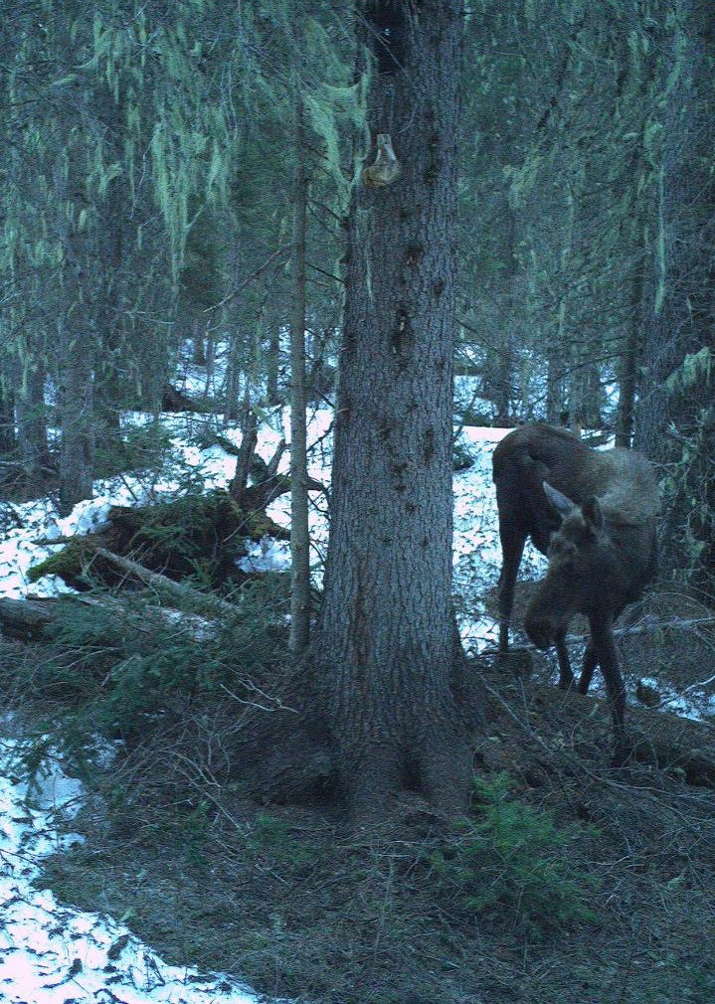

2026 winter north fork interlocal fish, wildlife and Parks

Slide 2
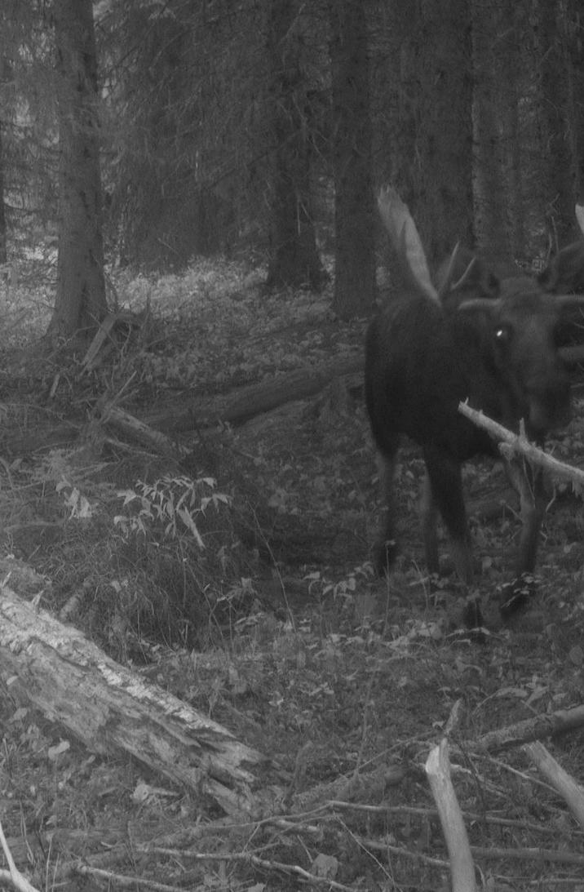
Large Mammal monitoring in northwest Montana (the Camera Project) David Messmer, Dustin Brewster and Co.

Slide 3
background
Objective: Develop a large mammal monitoring program in NW Montana
Abundance and Composition
Remote camera timelapse methodology
Measures camera viewshed
Project Start: July 2024
Expected Project End: 2028

Slide 4
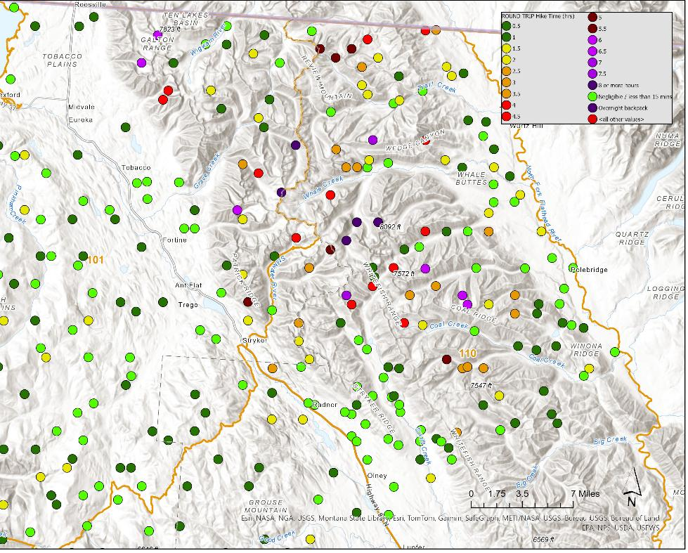
North Fork (HD 110) Field work
Fall 2024: Deployed 149 cameras
Random locations
June 2025: Start taking pictures
Synchronized every 10 min
20-50k photos/camera
Fall 2025: Begin camera retrieval
91 remaining for summer pickup
2026: Data Analysis
Estimates expected by winter 2026

Slide 5
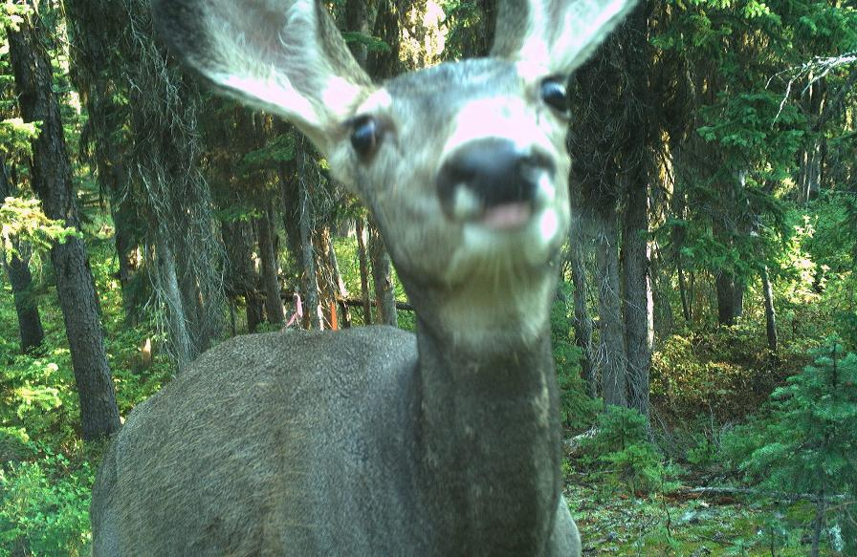
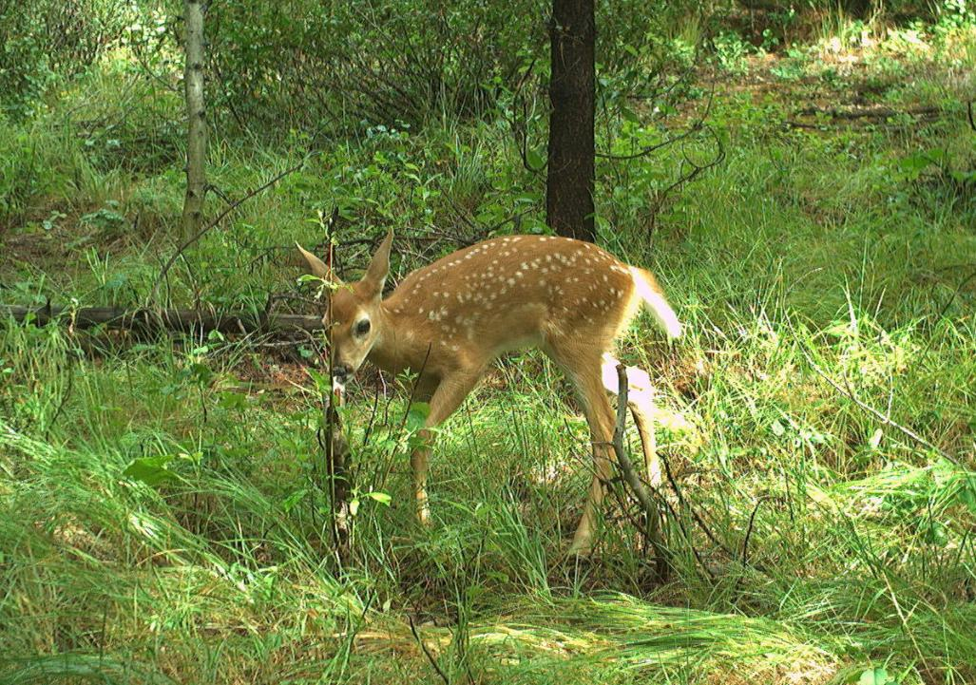
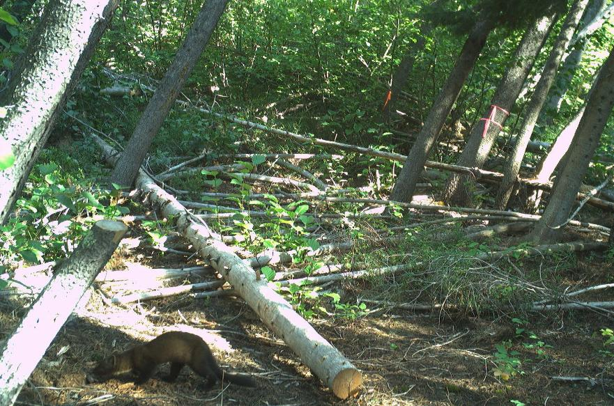
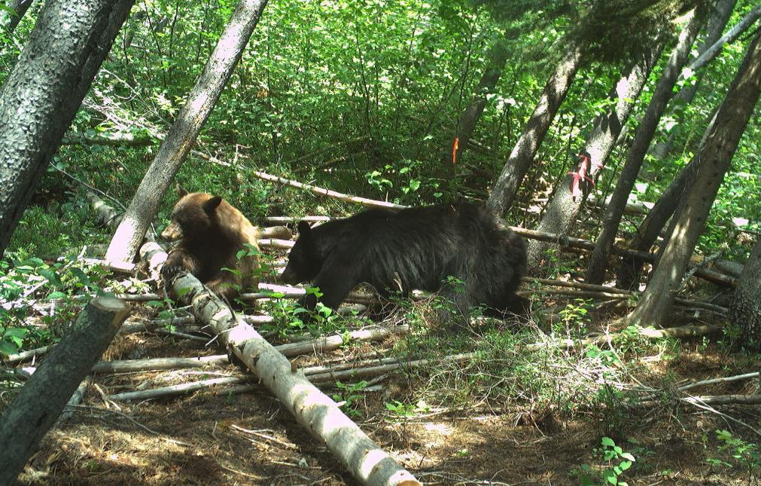
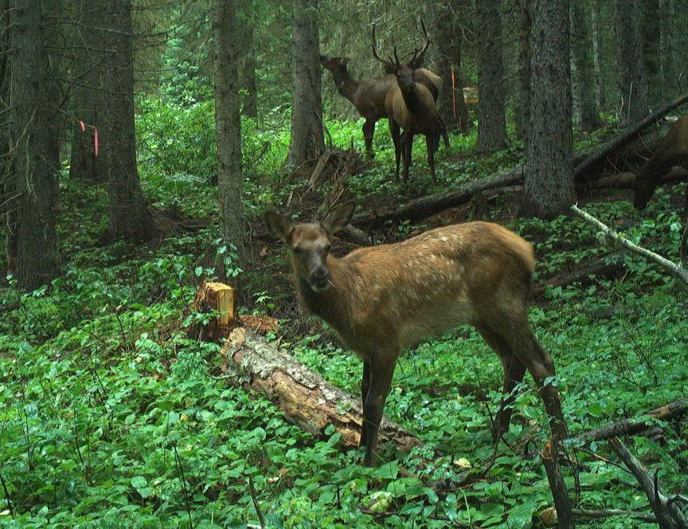
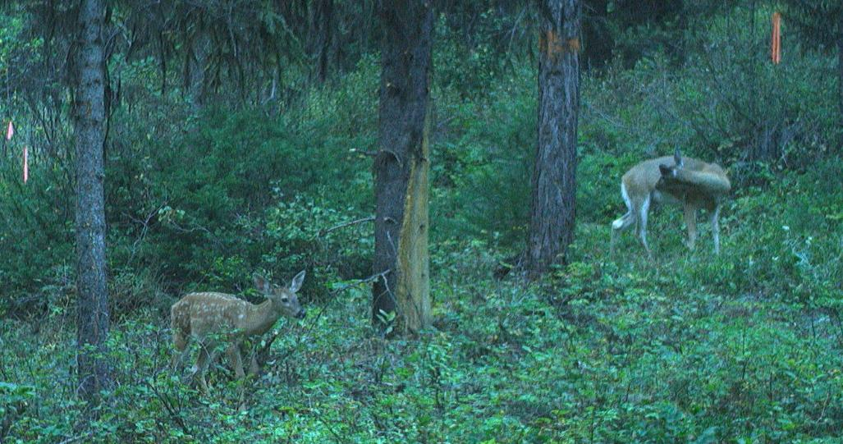
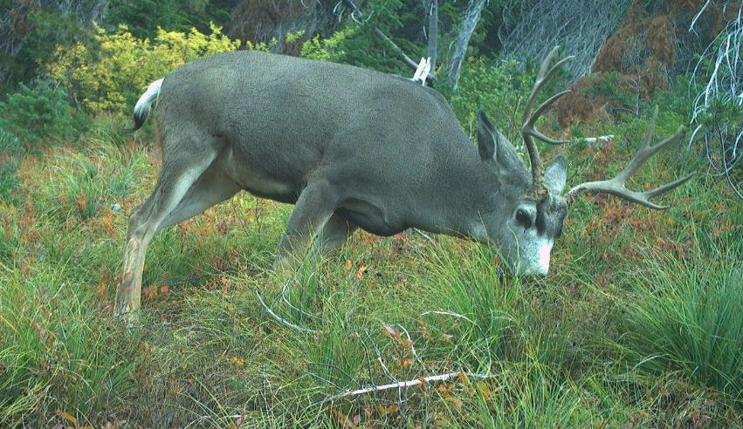
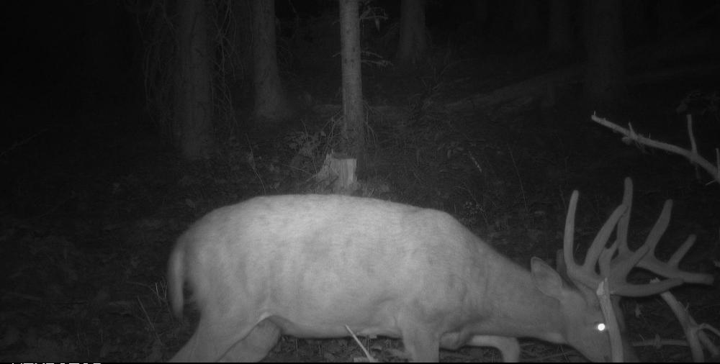
Sneak peak

Slide 6
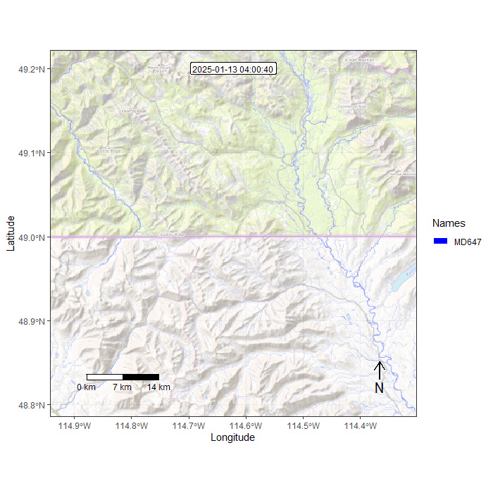
Ungulate collaring to improve model results
Mule deer doe collared near Grave Creek
Migration through Whitefish Range, across North Fork River and into BC
40miles direct

Slide 7
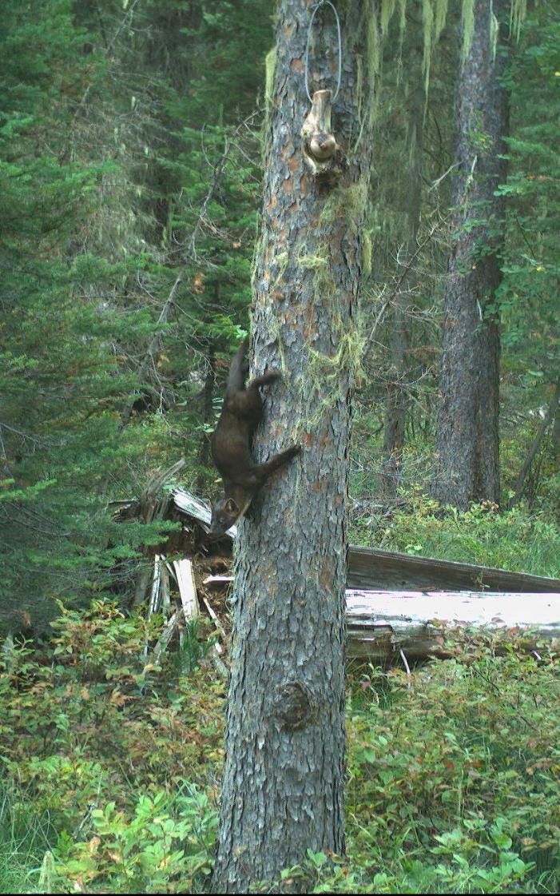

Marten Project
Nolan Helmstetter
Montana State University

Slide 8
Update
Ecology, distribution, occupancy and habitat relationships of pine marten in Montana
Summer/Fall 2025: Deployed 100 scent pumps w/ cameras in North Fork
57 in Great Bear Wilderness
Spring/Summer 2026: Retrieval and begin data analysis

Slide 9
Quick North Fork Wildlife Updates
Easy winter for ungulate species
No recent sightings of Camas bighorn sheep
Only 1 mountain lion harvest
Moose – Still calling moose hunters.
Wolverine – Next occupancy survey winter 2026/2027

Slide 10
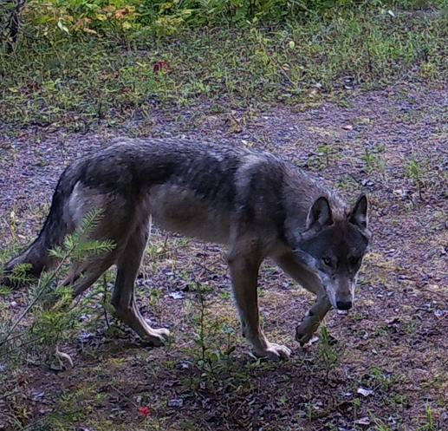
Wolf Update
Wendy Cole

Slide 11
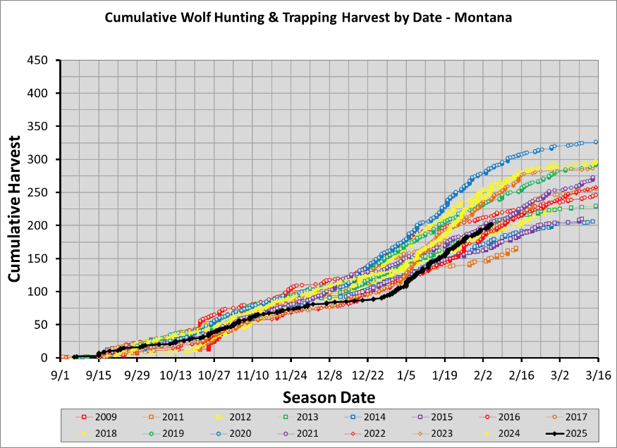
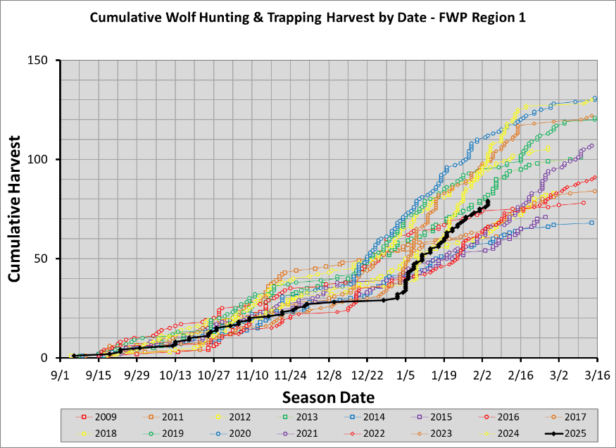
Statewide and Region 1 Wolf Harvest

Slide 12
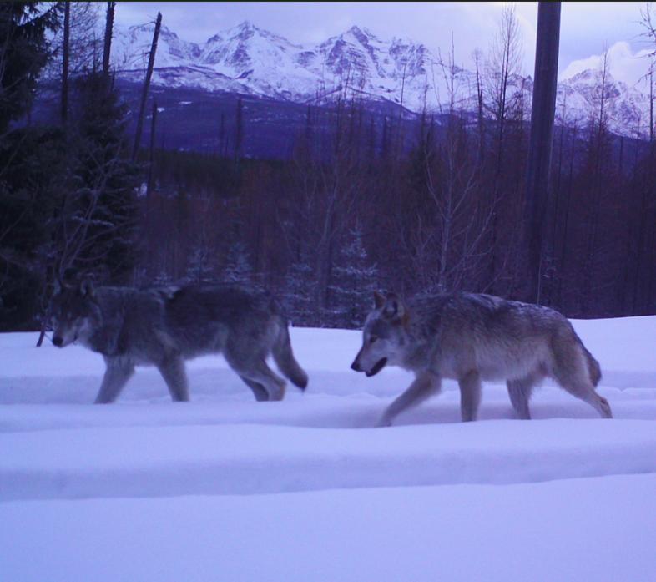
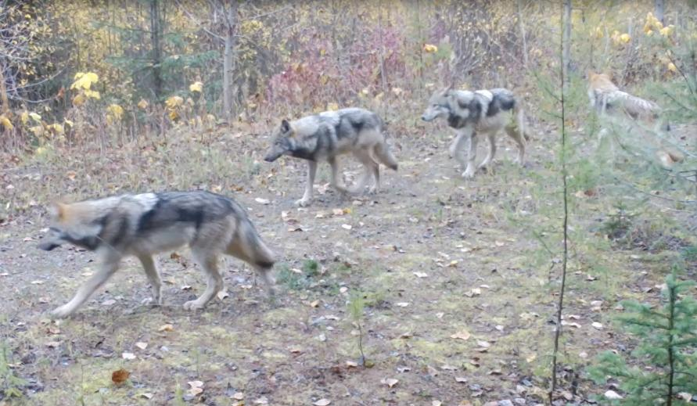
North Fork Wolf Update
Monitoring
2025/2026 Harvest: 2

Slide 13
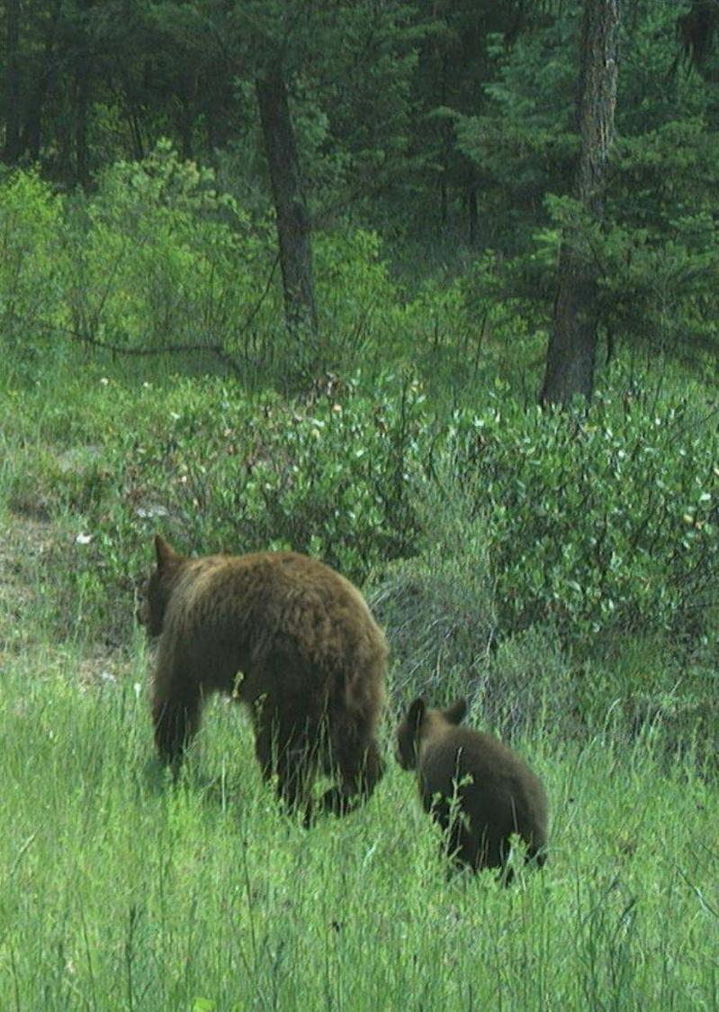
Bear update
Lori Roberts
Justine Vallieres

Slide 14

Enforcement update
McKenzie Clark

Slide 15
Interlocal Queries
Status of game camera studies on population monitoring
Update on other wildlife species
2025 wolf legislation impacts to North Fork
Update from bear biologists
Enforcement updates and furbearer trap monitoring
Update on Moose Creek fish barrier project

Slide 16
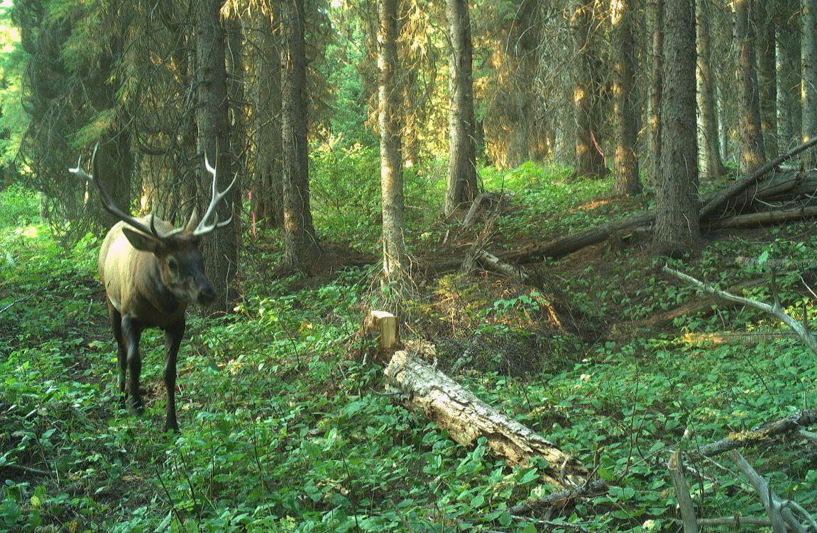
Thank you
Ethan Lula
Wildlife Biologist
Ethan.lula@mt.gov

